Slide 1
17th-18th September, 23
Daily News Juice
1. Kim Jong Un meets Putin, likely seeks advanced weapons technologies
2. PM Modi launches Global Biofuels Alliance (GBA)
3 What is Gresham’s law and how it affects currencies?
Prepmate.in
To get this Daily News Juice PDF, WhatsApp on 75979-00000

Slide 2
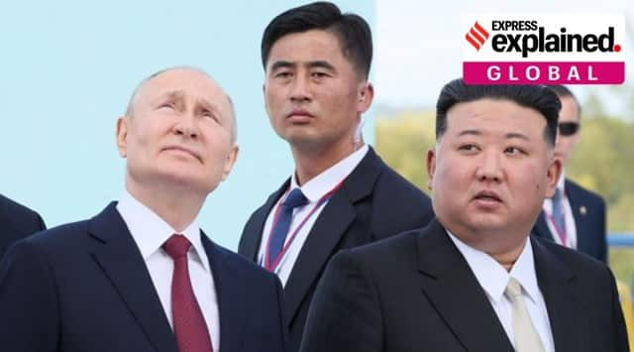
Kim Jong Un meets Putin, likely seeks advanced weapons technologies
Relevance: Prelims & Mains Paper II; International Relations
Why in news?
The North Korean leader Kim Jong Un and Russian President Vladimir Putin recently got together at a rocket launch facility in the Russian Far East. This was their first summit in four years.
The talks between the isolated, nuclear-armed leaders focused on expanding the military cooperation of two countries in intensifying confrontations with the West.
The venue of this meeting may communicate what Kim sees as the crucial next steps in his efforts to build a viable nuclear arsenal that could threaten the U.S. and its allies in Asia.
With the ability to supply vast stockpiles of munitions needed by Russia for its war in Ukraine, Kim in exchange may have sought badly needed economic aid and sophisticated weapons technologies to advance his military nuclear program.

Slide 3
Spy satellites
Intercontinental ballistic missiles
Kim’s visit to Russia came after North Korea experienced repeated failures to put its first military spy satellite into orbit. Though it has vowed to make a third try for the spy satellite, there are questions over whether its newly developed satellite would be sophisticated enough to monitor U.S. and South Korean military movements.
Kim has used the international distraction caused by Putin’s war on Ukraine to ramp up his weapons demonstrations, test-firing more than 100 missiles since 2022.
Space-based reconnaissance capabilities would potentially enhance the threat posed by Kim’s missiles. Notably, he has also authorized his military to conduct preemptive nuclear attacks against enemies if it perceives North Korea’s leadership as under threat.
The UN Security Council imposed economic sanctions on North Korea over its previous satellite launches, seeing them as covers for long-range ballistic missile tests.
Kim’s space ambitions are likely tied to his efforts to develop more powerful intercontinental ballistic missiles (ICBMs) that are designed to reach the US mainland.
This year, North Korea flight-tested its most advanced missile yet, the Hwasong-18, which demonstrated a potential range to reach deep into the US mainland.
However, it’s unclear if the country has acquired the technology to ensure that the warheads would survive the harsh conditions of atmospheric re-entry to strike targets.
Some experts suspect that’s an area where the North might ask for Russian help.

Slide 4
Submarines
Conventional weapons
Some analysts say Kim may also want Russian help in developing ballistic-missile submarines and nuclear propulsion submarines.
In recent years, North Korea tested a variety of missiles designed to be fired from submarines. Such capacity would bolster its deterrent by ensuring a survivable capability to retaliate after absorbing a nuclear attack on land.
Still, it would take considerable time, resources and technological improvements for North Korea to build a fleet of submarines that could travel quietly and execute attacks reliably.
However, analysts say such capacities would likely be unfeasible for North Korea without external assistance.
Some analysts question whether Russia, which has always closely guarded its most important weapons technologies, even from key partners like China, would be willing to share them with North Korea.
As per South Korean analysts, the military cooperation between Russia and North Korea was more likely to center around conventional capabilities.
Russia could possibly help North Korea improve its badly aged air force or provide anti-aircraft missiles to strengthen the latter’s defence.

Slide 5
PM Modi launches Global Biofuels Alliance (GBA)
Relevance: Prelims & Mains Paper III; Economics
Why in news?
Details
PM Narendra Modi recently announced the launch of Global Biofuels Alliance (GBA) on the sidelines of the G20 Summit. 19 countries and 12 international organisations have already agreed to join the alliance.
GBA is an India-led Initiative to develop an alliance of govts, international organizations and industry to facilitate the adoption of biofuels.
Bringing together the biggest consumers and producers of biofuels to drive biofuels development and deployment, the initiative aims to position biofuels as a key to energy transition and contribute to jobs and economic growth.
GBA is supported by G20 Nations & energy related global organisations like International Energy Agency (IEA), International Civil Aviation Organization (ICAO), World Economic Forum (WEO), and World LPG Association among others.
It will strengthen global biofuels trade & best practices allowing the members to successfully face the Energy Quadrilemma.
GBA will support worldwide development and deployment of sustainable biofuels by offering capacity-building exercises across the value chain, technical support for national programs and promoting policy lessons-sharing.
It will facilitate mobilizing a virtual marketplace to assist industries, countries, and ecosystem players in mapping demand and supply, as well as connecting technology providers to end users.
GBA will also facilitate development, adoption and implementation of internationally recognized standards, codes, sustainability principles and regulations to incentivize biofuels adoption and trade.

Slide 6
Potential benefits for India
Facts and figures
GBA will be beneficial for India at multiple fronts. As a tangible outcome of the G20 presidency, it will help strengthen India’s position globally.
Moreover, the alliance will focus on collaboration and will provide additional opportunities to Indian industries in the form of exporting technology and exporting equipment.
It will help accelerate India’s existing biofuels programs such as PM-JIVANYojna, SATAT, and GOBARdhan scheme, thereby contributing to increased farmers’ income, creating jobs and overall development of the Indian ecosystem.
As per the govt, this will bolster the transformation of Indian farmers from ‘Annadatas to Urjadatas’ as an additional source of income. It claims to have provided ₹71,600 cr to its farmers in the last 9 years.
With E20 implementation by 2025, India will save about ₹45,000 cr in oil imports and 63 MT of oil annually.
The global ethanol market was valued at USD 99.06 billion in 2022 and is predicted to grow at a CAGR of 5.1% by 2032 and surpass USD 162.12 billion by 2032.
As per IEA, there will be 3.5-5x biofuels growth potential by 2050 due to Net Zero targets, creating a huge opportunity for India.

Slide 7
What is Gresham’s law and how it affects currencies?
Relevance: Prelims & Mains Paper III; Economics
Details
Gresham’s law refers to the statement that “bad money drives out good.” This law comes into play when the exchange rate between two moneys or currencies is fixed by the government at a certain ratio that is different from the market exchange rate.
Such price fixing causes the undervalued currency — that is, the currency whose price is fixed at a level below the market rate — to go out of circulation. The overvalued currency, on the other hand, remains in circulation but it does not find enough buyers.
It should be noted that the market exchange rate is essentially an equilibrium price at which the supply of a currency is equal to the demand for the currency.
Also, the supply of a currency in the market rises as its price rises and falls as its price falls; while, on the other hand, the demand for a currency falls as its price rises and rises as its price falls.
So, when the price of a currency is fixed by the govt at a level below the market exchange rate, the currency’s supply drops while demand for the currency rises.
Thus, a price cap can lead to a currency shortage with demand for the currency outpacing supply..

Slide 8
Origins of the term
Gresham’s law is named after English financier Thomas Gresham who advised the English monarchy on financial matters.
It applies not just to paper currencies but also to commodity currencies and other goods.
In fact, whenever the price of any commodity — whether it is used as money or not — is fixed arbitrarily such that it becomes undervalued when compared to the market exchange rate, this causes the commodity to disappear from the formal market.
The only way to get hold of an undervalued commodity in such cases would be through the black market. Sometimes, countries can even witness the outflow of certain goods through their borders when they are forcibly undervalued by govts.
Gresham’s law can be seen at play whenever a govt fixes the exchange rate (or price) of a commodity money (such as gold and silver coins) far below than the market price of the commodity backing them. In such cases, people who hold the commodity money would stop offering the money at the price fixed by the govt.
They may even melt such commodity money to derive pure gold and silver that they can sell at the market price, which is higher than the rate fixed by the govt.

Slide 9
A real-world example…
Gresham’s law came into play most recently during the economic crisis in Sri Lanka last year, during which the Sri Lankan central bank fixed the exchange rate between the Sri Lankan rupee and the U.S. dollar.
The Central Bank of Sri Lanka, at a certain point, mandated that the price of the U.S. dollar in terms of the Sri Lankan rupee should not rise beyond 200 rupees per dollar even though rates in the black market suggested that the U.S. dollar should sell for far more than 200 rupees.
In effect, people were banned from paying more than 200 Sri Lankan rupees for a dollar, thus causing the rupee to be overvalued and the U.S. dollar to be undervalued when compared to the market exchange rate.
This caused the supply of dollars in the market to fall and the U.S. dollar to be gradually driven out of the formal foreign exchange market. People who wanted U.S. dollars to purchase foreign goods then had to purchase dollars from the black market by paying far more than 200 Sri Lankan rupees for each U.S. dollar.

Slide 10
Necessary conditions
Gresham’s law holds true only when the exchange rate between currencies is fixed under law by the govt and the law is implemented effectively by authorities. In the absence of any govt decree fixing the exchange rate between currencies, it is good money that eventually drives bad money out of the market and not the other way round.
When the exchange rate between currencies is not fixed and people have the choice to freely choose between currencies, people gradually stop using currencies that they consider to be of poor quality and adopt currencies that are found to be of better quality.
This phenomenon wherein “good money drives out bad” is called Thiers’ law (named after French politician Adolphe Thiers) and it is seen as a complement to Gresham’s law.
The rise of private cryptocurrencies in recent years has been cited by many analysts as an example of good money issued by private money producers driving out bad money issued by govts.

Slide 11
This News Analysis is just a sample. We have an exceptional skill to produce high quality and error free content.
If you are looking for high quality study material to Prepare for Civil Services Exam, then next page is awaiting you….
Message from Shubham Singla Author Civil Services Coach B Com Hons., CA, CISA, Ex-Civil Services Aspirant

Slide 12
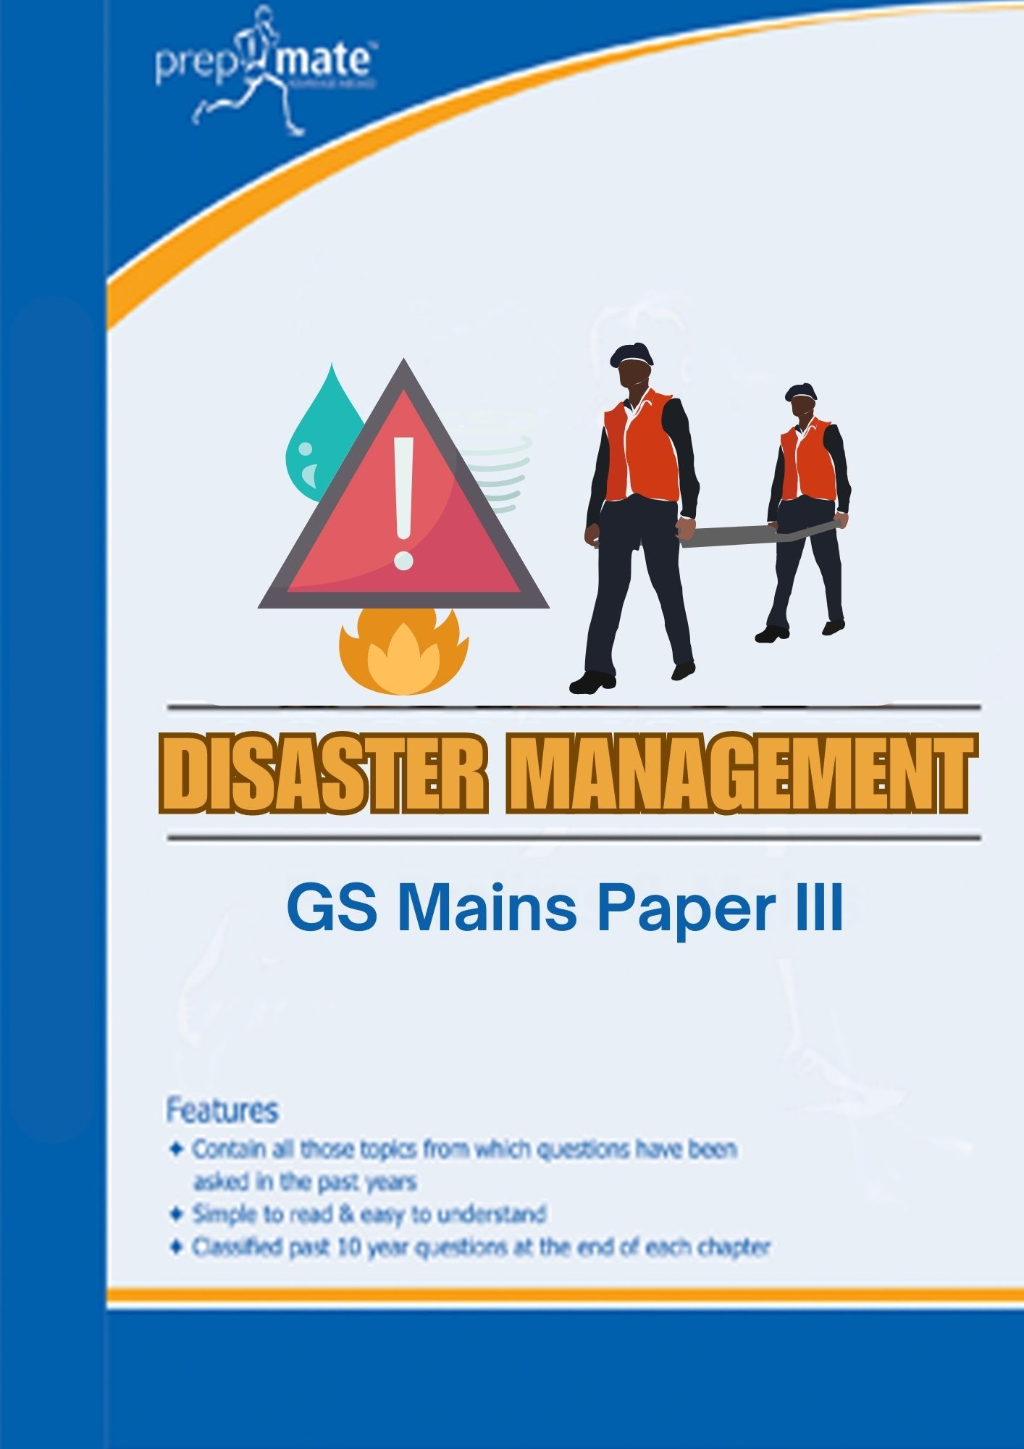
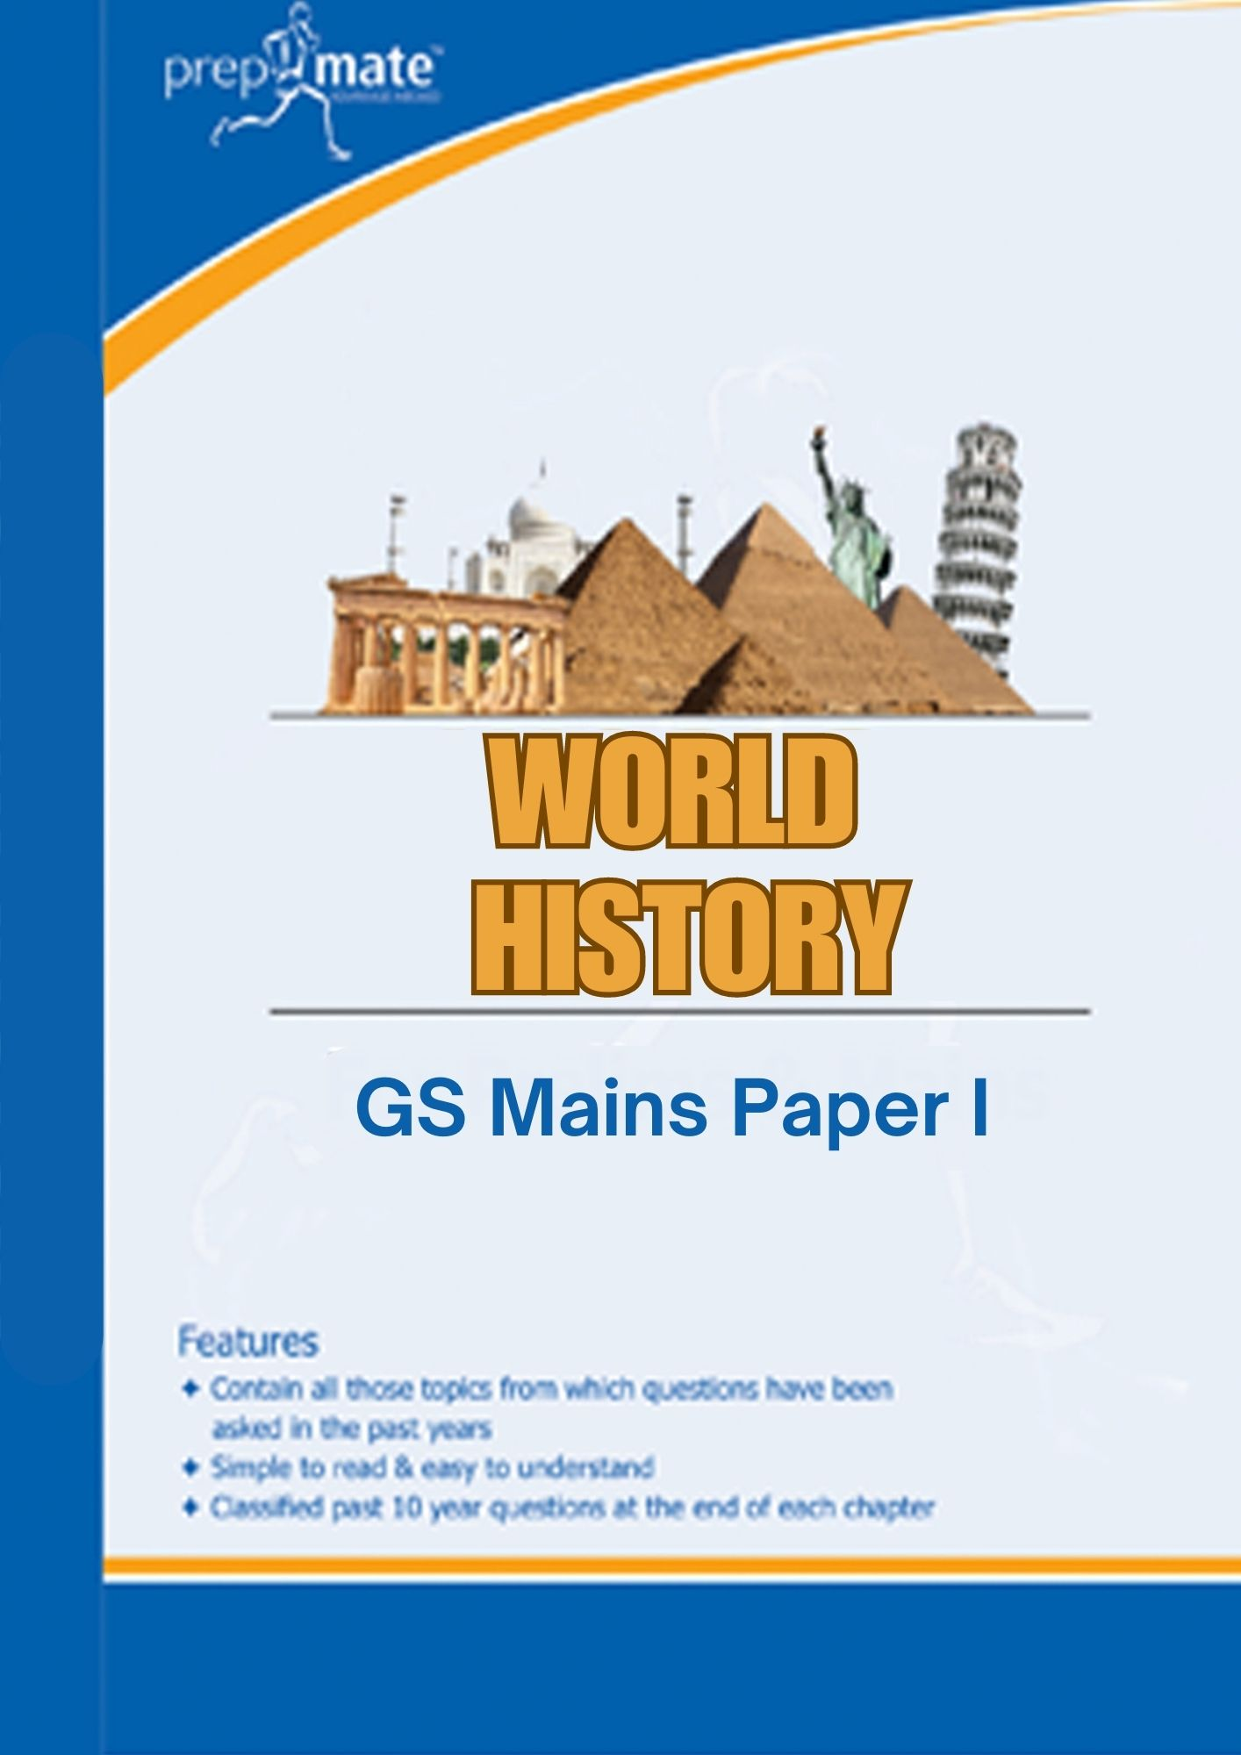
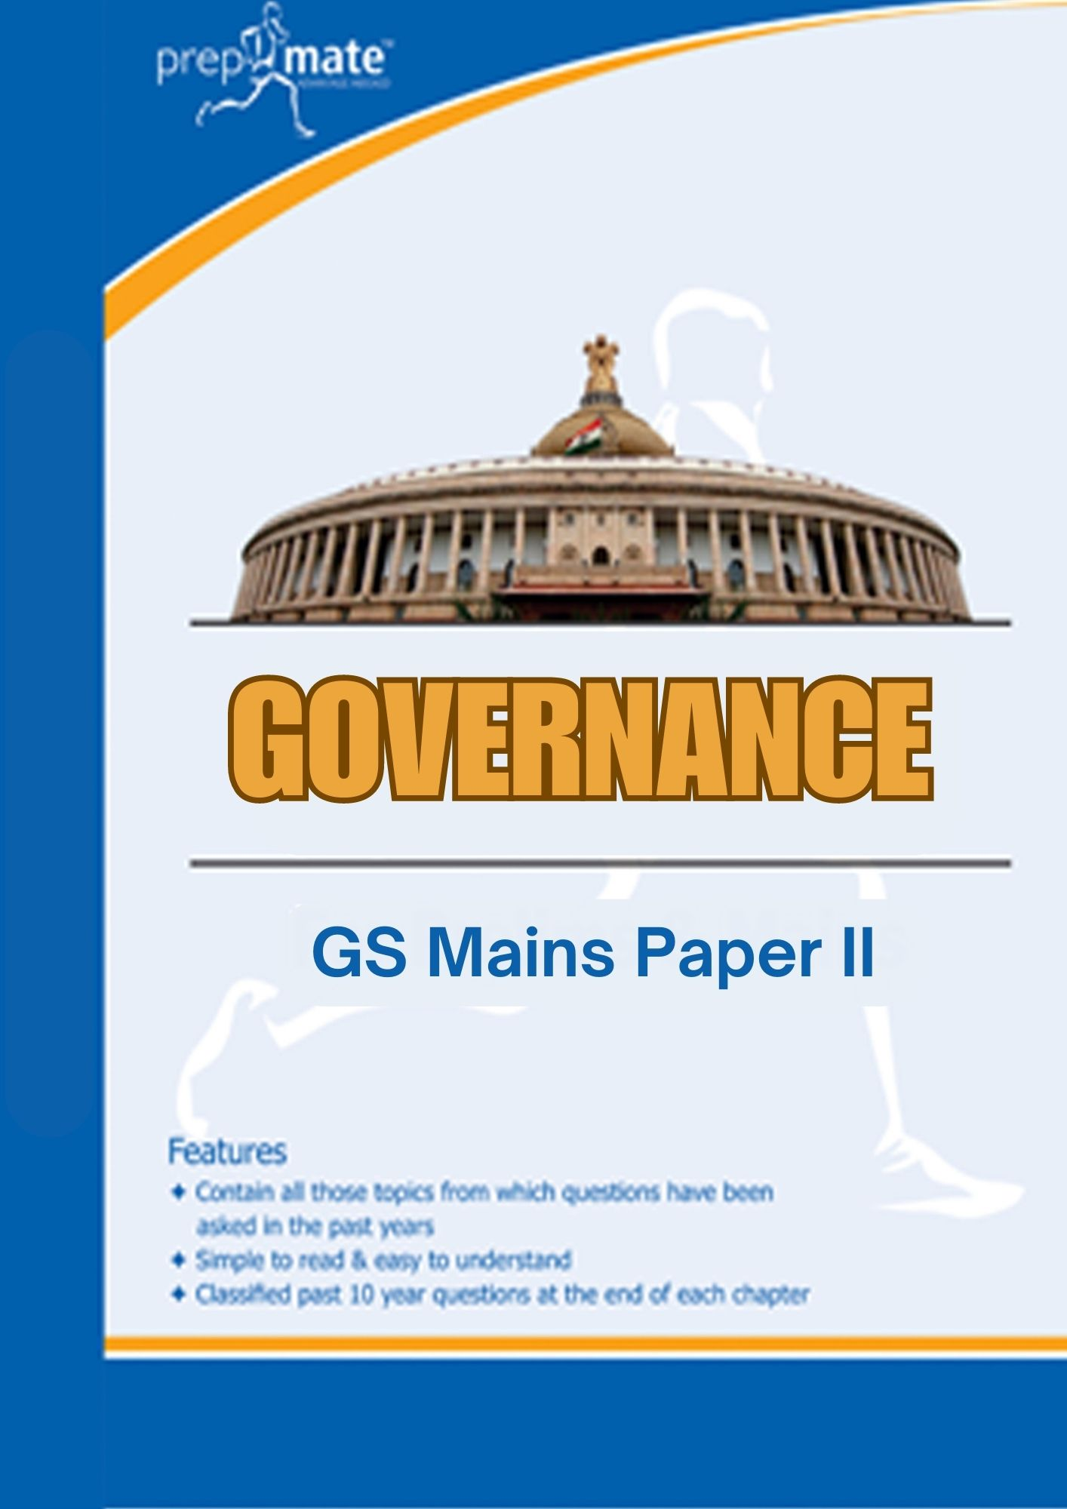
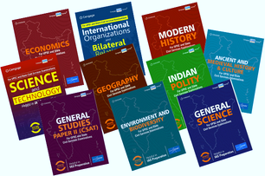
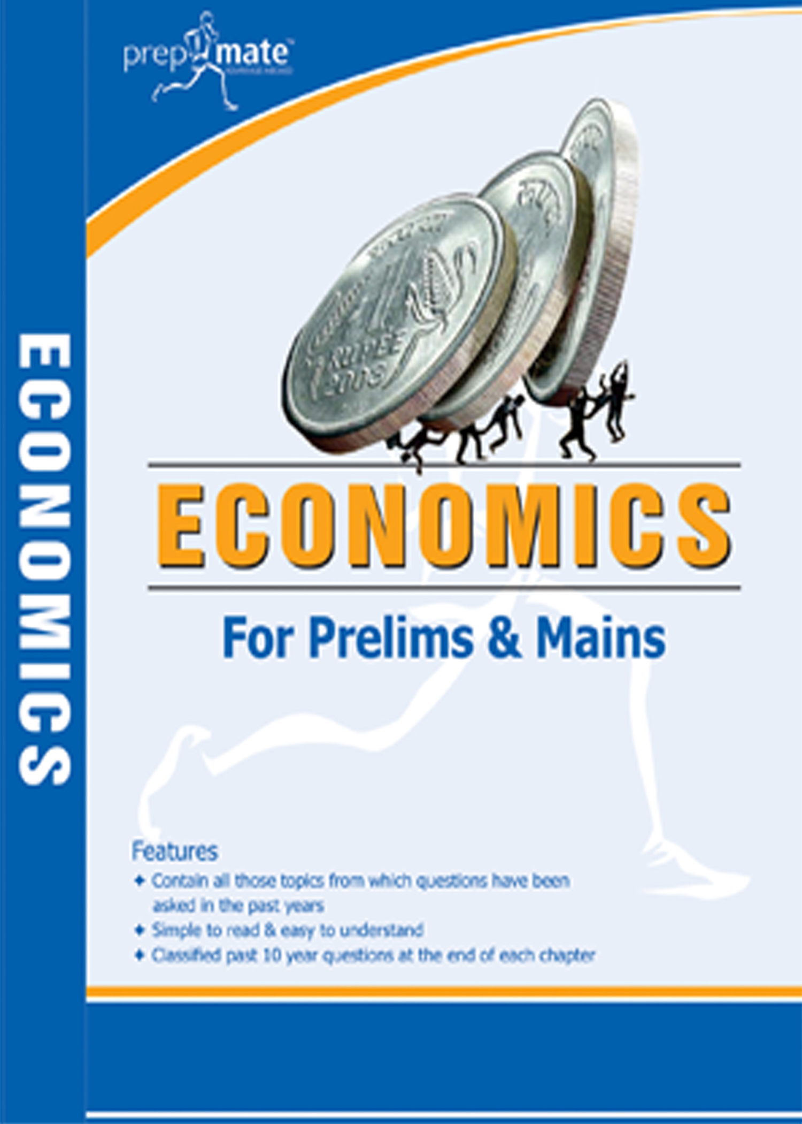
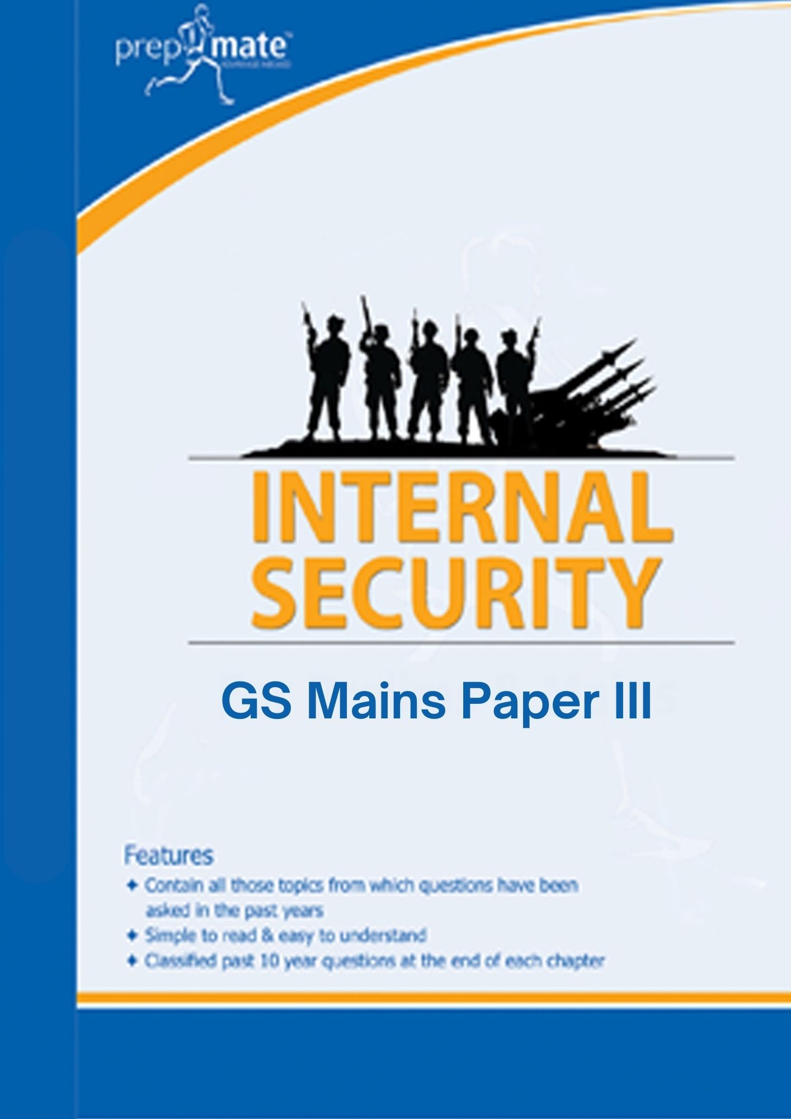
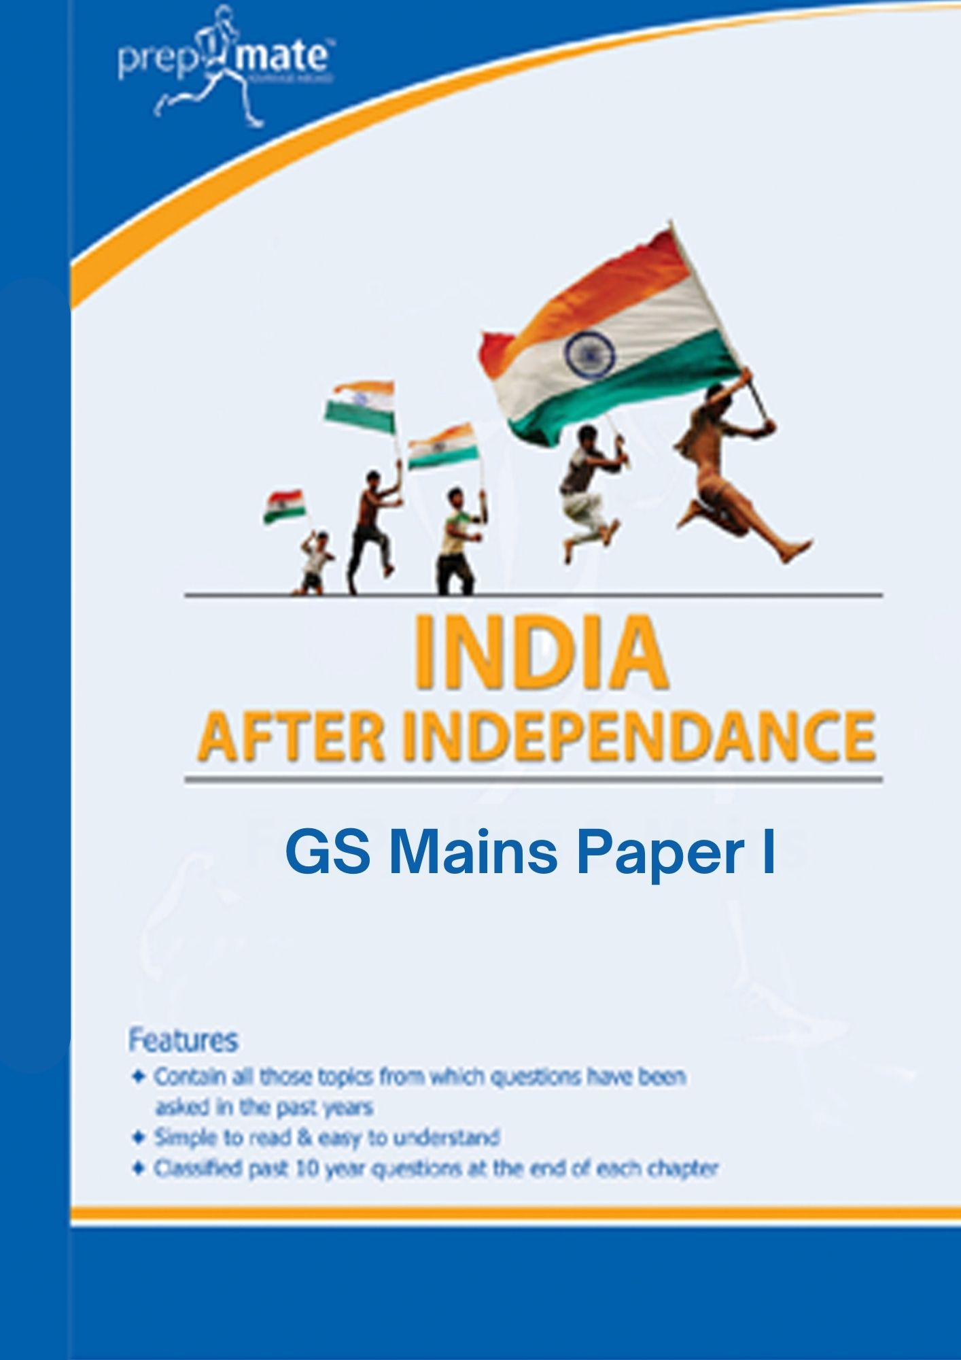
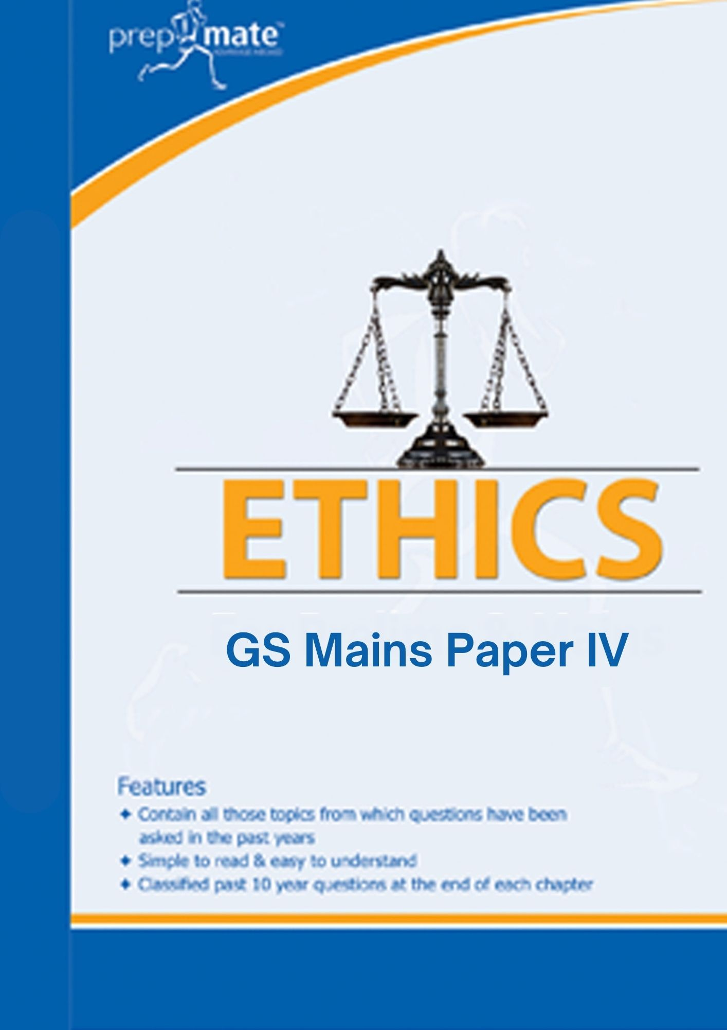
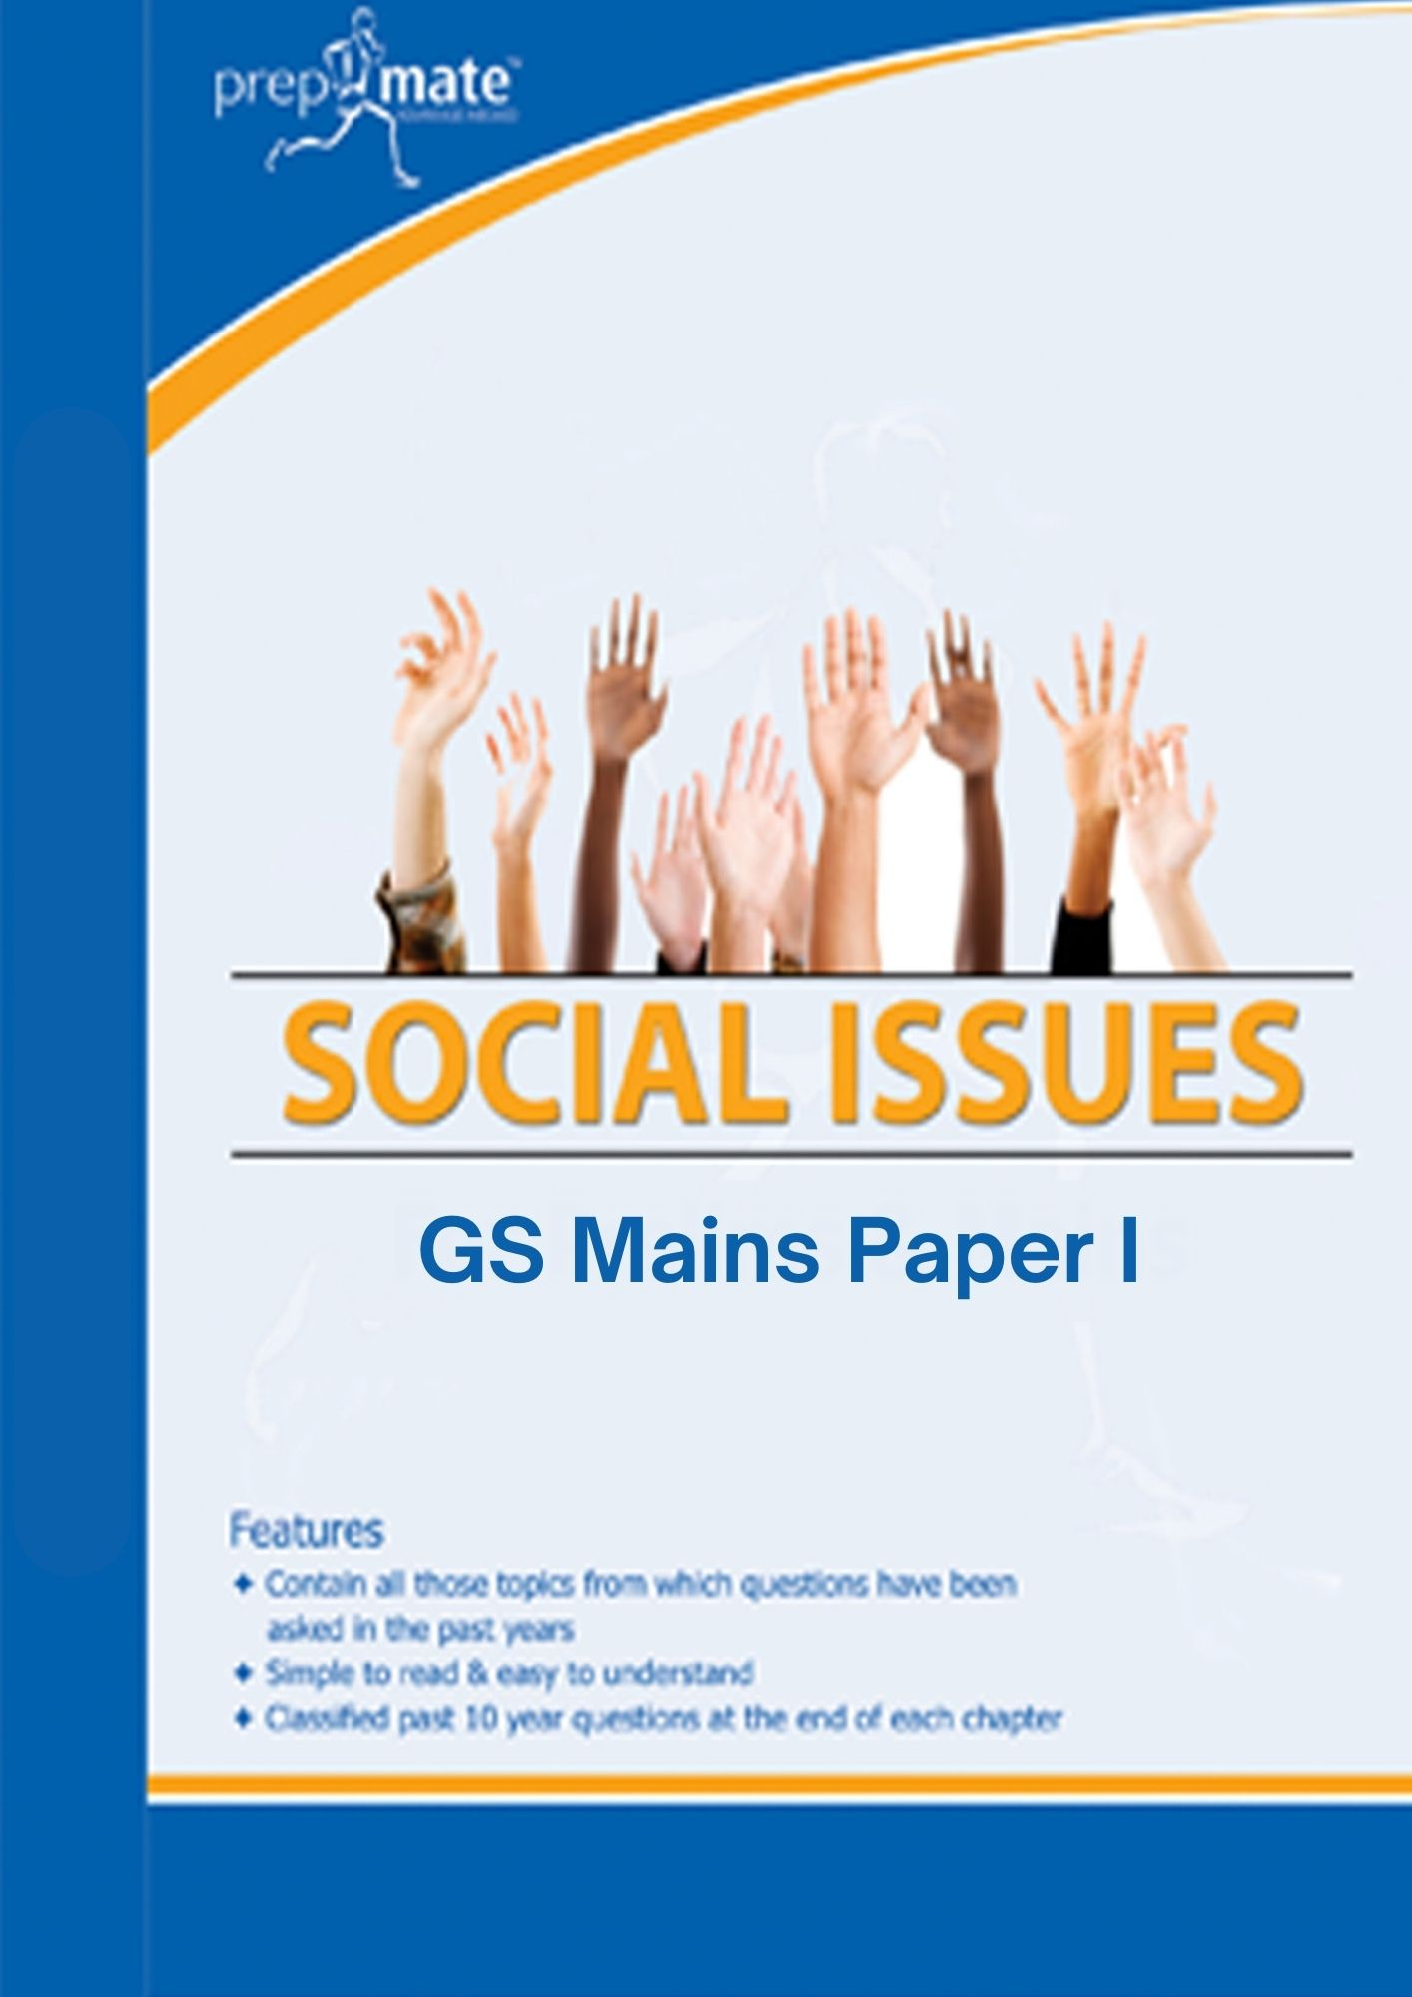
GS Pre-cum-Mains Study Material for IAS Preparation
1. 10 Published Books for
Pre cum Mains
2. Value Added Material
3. Mains Study Material
Rs. 10,000/-
4. Guidance
To Order send ‘Study material for IAS’ on WhatsApp number 75979-00000

